Slide 1
Quality in clinic
Dr. Lucy Goldby
We can make you better

Slide 2
Quality Agenda
Shifting Agenda Nationally and CSP
What does this mean for me, why audit
OK so I want to get involved
Cemplicity and data collection
Our data and how we use it….

Slide 3
So What’s Happening?
HQIP - Healthcare Quality Improvement Partnership - the UK Government - they deliver national clinical audit programmes
Enabling those who commission, deliver and receive healthcare to measure and improve healthcare services
Audit MSk Outpatient Physiotherapy NHS and Independent
What stage are we at?
Who is doing this?
CSP
Physiofirst / MSKPN?
Keele University

Slide 4
Why are we doing this?
Audit Why Bother
Personalised treatment plans
Understand individual responses to Rx
Make timely adjustments
Improved patient outcomes
Regular analysis and effective measurement
Treatment validation for specific conditions
ICD 11 coding……
Cost effectiveness
Enhanced clinical decision making
Treatment validation - validation of evidence based Medicine
Patient engagement and satisfaction
Accountability……
Primary work setting | Physiotherapist | % of total
NHS service providers | 21,600 | 42.2%
Private/ Independent service providers | 9,605 | 18.8%
Local authority / Social care / Community services | 6,505 | 12.7%
Not recorded* | 4,980 | 9.7%
Other | 3,095 | 6.0%
Prefer not to say | 2,555 | 5.0%
Higher education/Academia/Research | 1,280 | 2.5%
Third sector/not for profit | 390 | 0.8%
Care homes | 360 | 0.7%
Commissioning, policy or representative body | 360 | 0.7%
Hospice/palliative care | 255 | 0.5%
Schools | 215 | 0.4%
Prison/justice system | 20 | 0.0%
Total | 51,220
Counts (rounded to the nearest 5)
Political
What’s happening in NHS Msk Physiotherapy?
Three sessions??…How did this come about
Do we really want an audit on that?
HCPC
Standards September 2023
Engage with Healthcare technologies to record audit and evaluate delivery of care and outcome…

Slide 5
A National Audit? The MSKPN
Our journey - MSKPN - what do we know about who is auditing
What can I offer Keele?
53% membership returned their questionnaire..
Assume 47% are not collecting transferable data
Are you set up for data collection
30% Cemplicity
Our results
30% collect data automatically
Collecting electronically ranges from 40% (pain) to 4% (PASS)
Manual collection ranges from 28% (pain) to 8% (PASS)
Not collecting data ranges from 60% (PASS) to 4% (pain)
If anyone else is thinking of joining Cemplicity do it now

Slide 6
Most popular reasons for not collecting data are
Time - 40 %
Staff challenges
System Limitations
Talking to PM systems and Cemplicity with regards to this……
But would the data be useful to you…..

Slide 7
How do we use the data?
We can make you better
Friday Bulletin
Dr Lucy Goldby

Slide 8
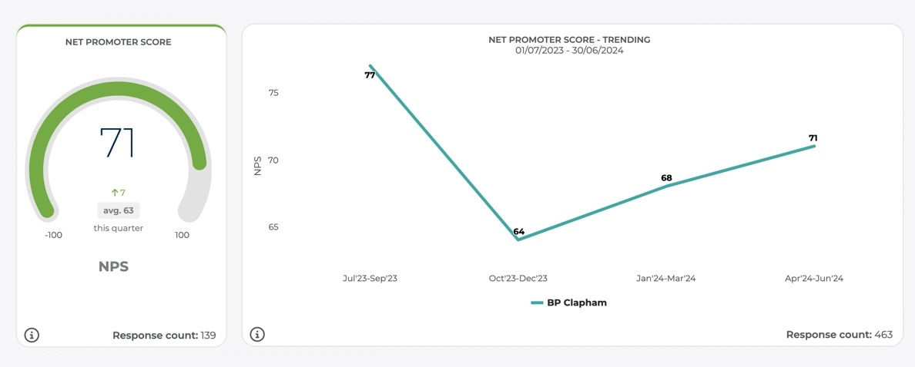
How do we use the data?
We can make you better
Friday Bulletin
Staff motivation and congratulations
Dr Lucy Goldby

Slide 9
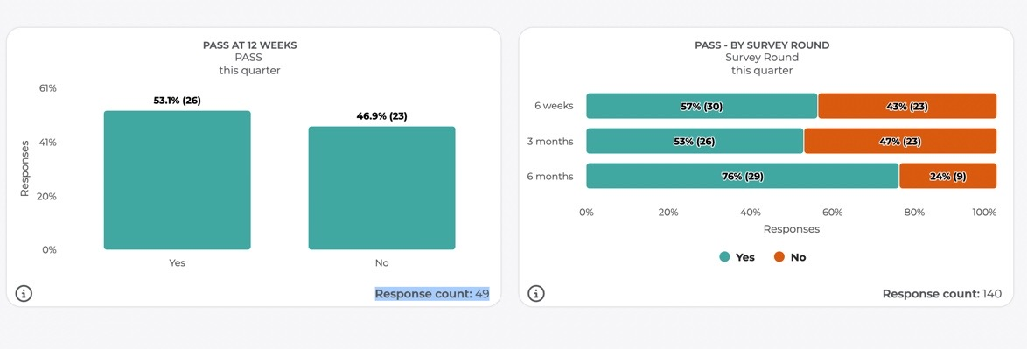
How do we use the data?
We can make you better
Friday Bulletin
Dr Lucy Goldby

Slide 10
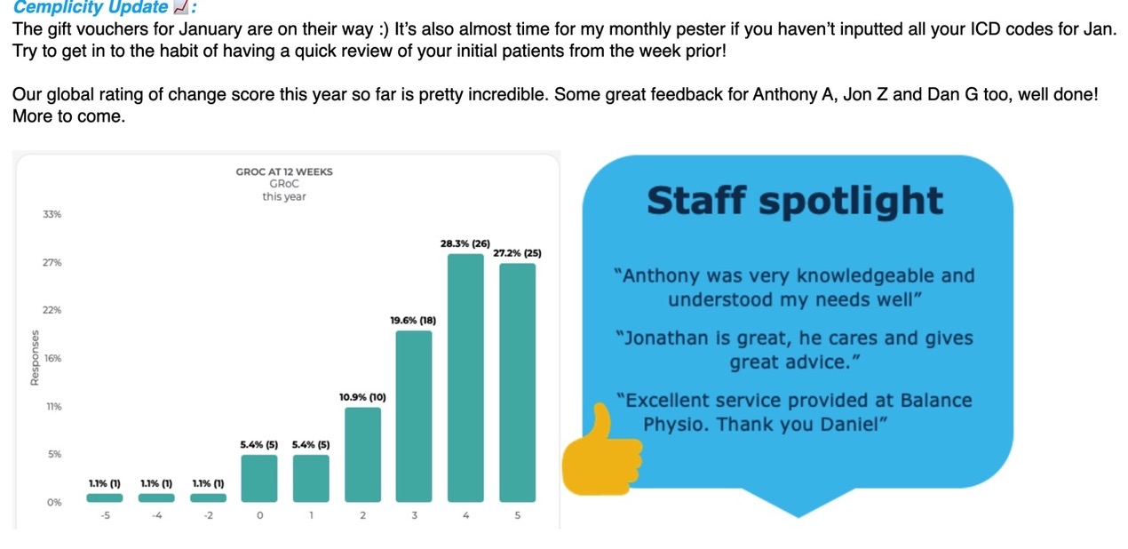
How do we use the data?
We can make you better
Friday Bulletin
Dr Lucy Goldby

Slide 11
How do we use the data?
We can make you better
Dr Lucy Goldby

Slide 12
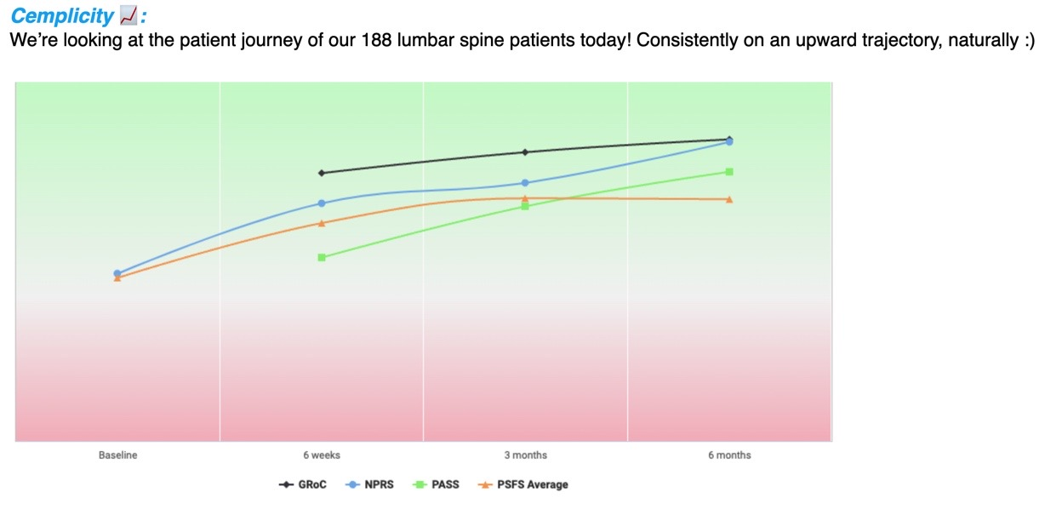
How do we use the data?
We can make you better
Friday Bulletin
Dr Lucy Goldby

Slide 13
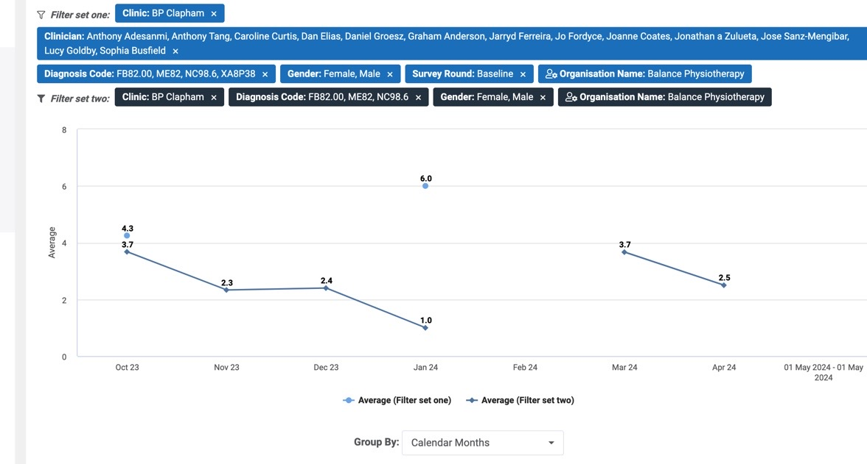
How do we use the data?
We can make you better
Clinical data
Dr Lucy Goldby

Slide 14
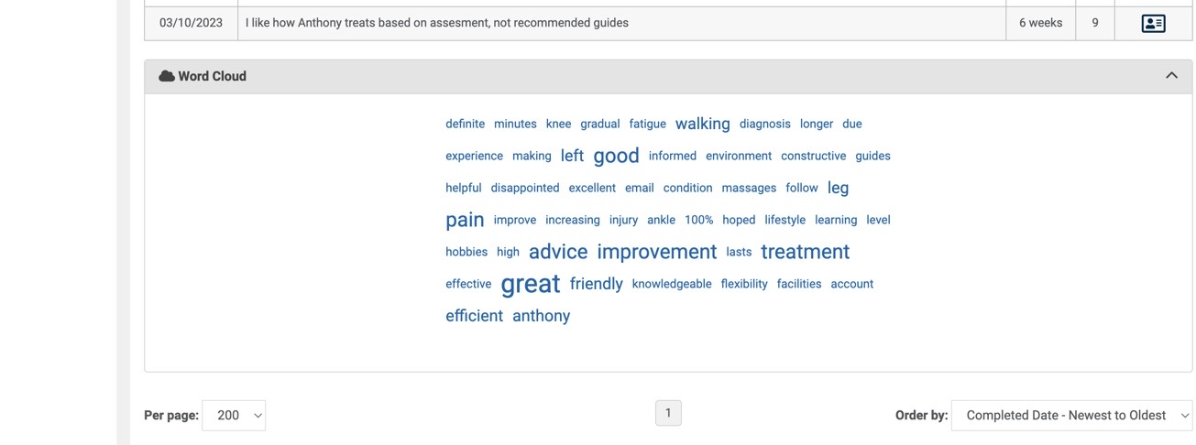
How do we use the data?
We can make you better
360 Reviews
Dr Lucy Goldby

Slide 15
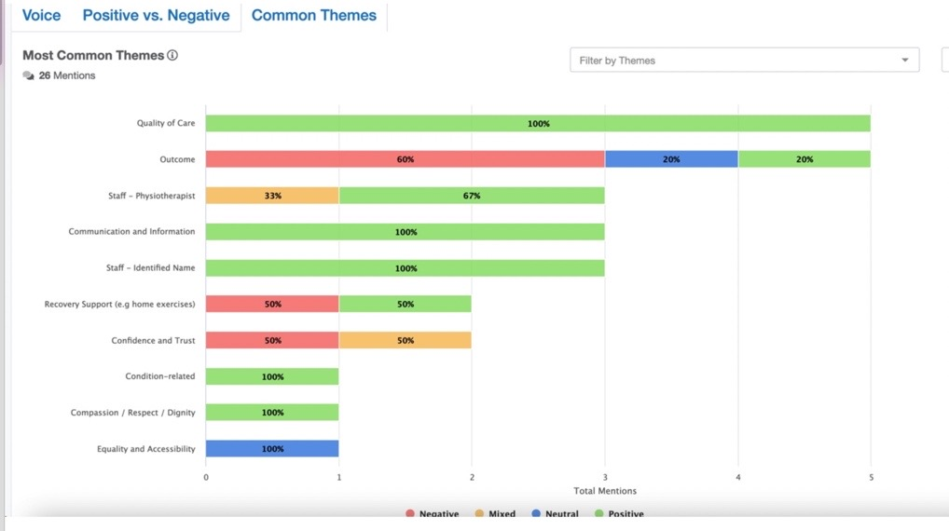
How do we use the data?
We can make you better
360 Reviews
Dr Lucy Goldby

Slide 16
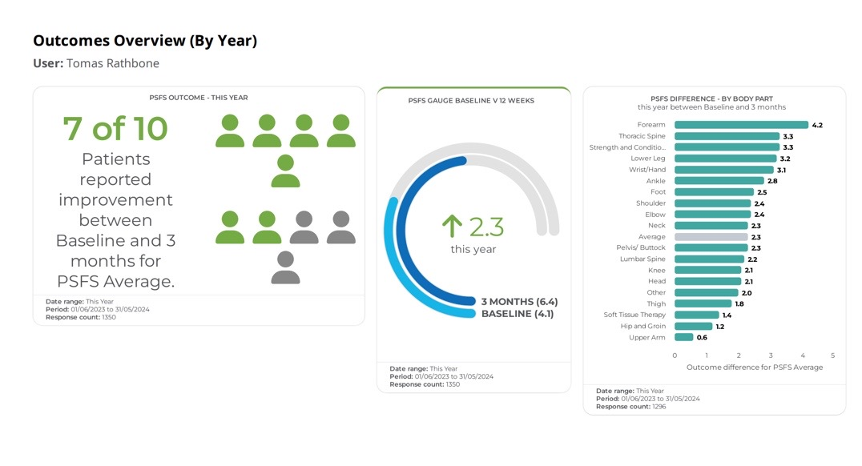
How do MSKPN use the data?
We can make you better
Benchmarking
Dr Lucy Goldby

Slide 17
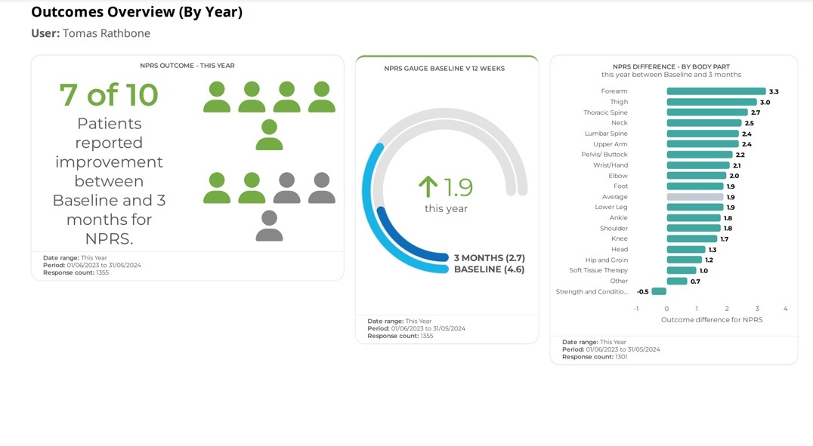
How do MSKPN use the data?
We can make you better
Benchmarking
Dr Lucy Goldby

Slide 18
What does MSKPN need?
What are you doing
Did you fill in the questionnaire
Can you participate in the national audit?
Let us know, speak to Cemplicity
Can you transfer your data ?
Can you interpret your data!
Dr Lucy Goldby

Slide 19
Dr Lucy Goldby

